Slide 1

FOOD & BEVARAGES
Food and Beverages: The industry that produces, prepares, and serves edible items and drinks, covering everything from packaged goods to restaurants and cafes.

Slide 2

 |  |  |  | 1.68 $ Trillion
 |  |  |  |  | CAGR 6.3 %
Market size
In 2025, the U.S. food and beverage industry is valued at approximately $1.68 trillion, reflecting a compound annual growth rate (CAGR) of 6.3% from 2023 to 2027.

Slide 3
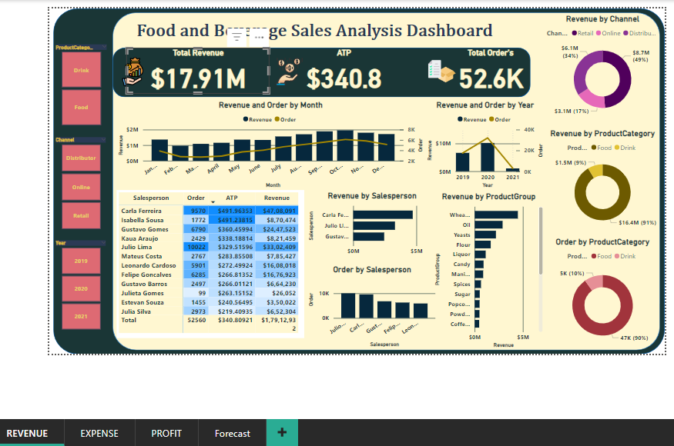
OVERVIEW
Card
Card of Dashboard
Revenue Channel
Revenue by Product Category
Filter using Slicer

Slide 4


F&B
SALES
SALE-PERSON
PRODUCT
Expense
Profit
Filter
INFORMATION FLOW

Slide 5
CHANNEL
ORDER DATE
DATASET WITH MASTER
PROFIT/UNIT
SALESPERSON
KEY
ID
MANAGER
ORDER
SALES AMOUNT
SALES
PERSON
PROFIT
PRODUCT
GROUP
REVENUE
PRODUCT
CATEGORY
ATP
SUPERVISOR
EXPENSE
PRODUCT KEY
Quantity
UNIT
PRICE

Slide 6
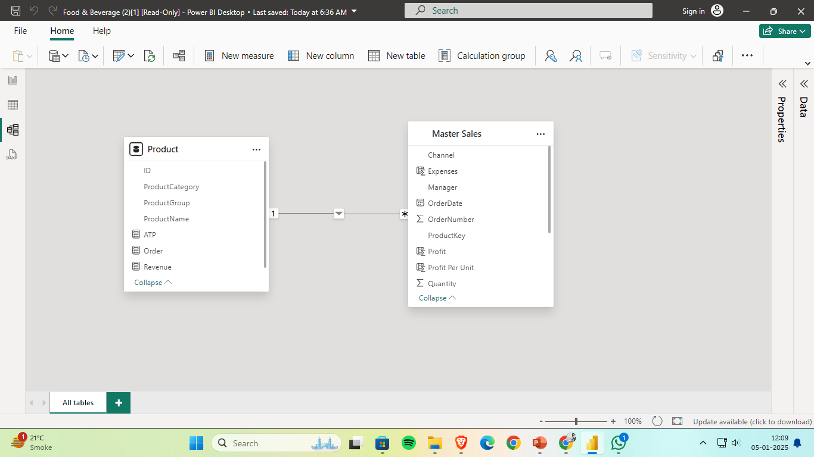
DATA MODELLING & CARDINALITY REALATONSHIP
ONE TO MANY REALTIONSHIP
ID – PRIMARY KEY
PRODUCTKEY – FOREIGN KEY

Slide 7
DAX : Data Analytics Expression
MEASURES
COLUMN
Revenue = SUM(Sheet1[Sales Amount])
Order = DISTINCTCOUNT(Sheet1[Order Number])
ATP = DIVIDE('Product'[Revenue],'Product'[Order],"")
Sales Amount = Sheet1[Quantity]*(Sheet1[UnitPrice])
Expenses = [Sales Amount]*0.2
Profit = Sheet1[Sales Amount]-Sheet1[Expenses]

Slide 8
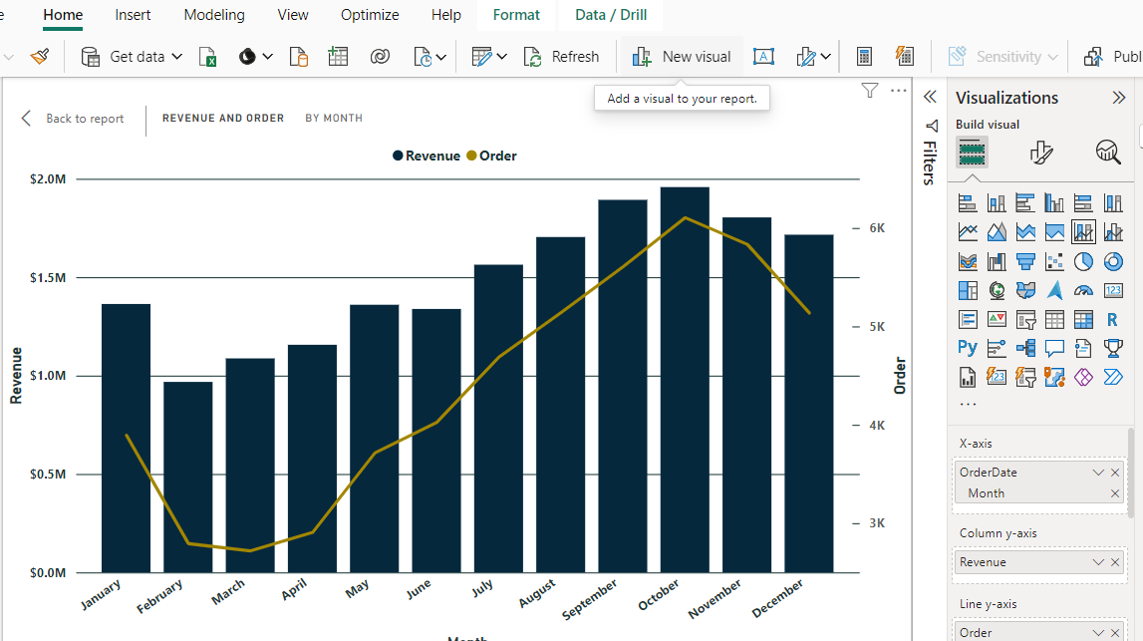
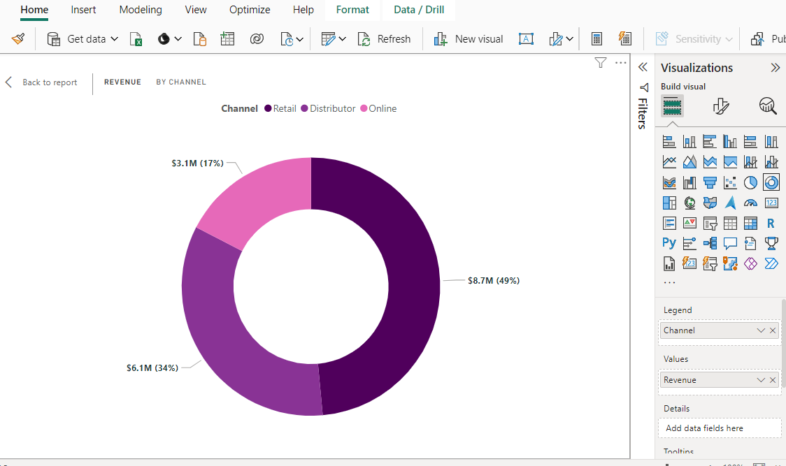
VISUALIZATION
Line& Stacked Column Chart
Donut Chart
X axis – Order Date
Y axis – Profit
Its help to show the monthly wise Revenue, Trend.
Legend– Channel
Values - Revenue
Its help to show the Channel wise Revenue
Retail
Distributer
Online

Slide 9
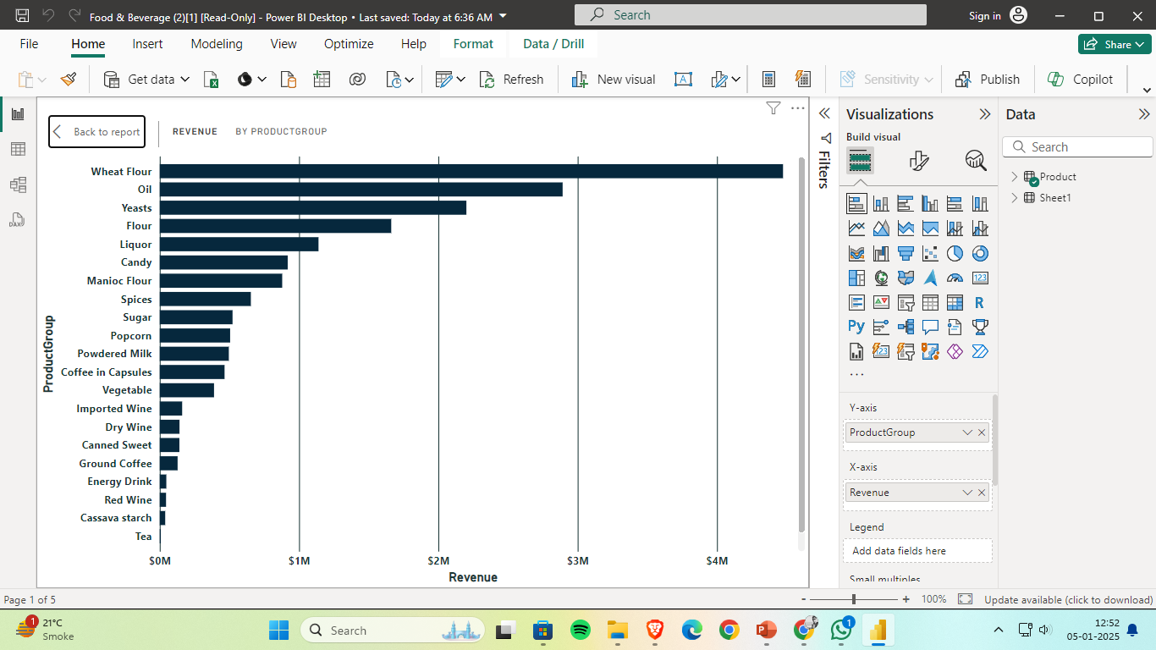
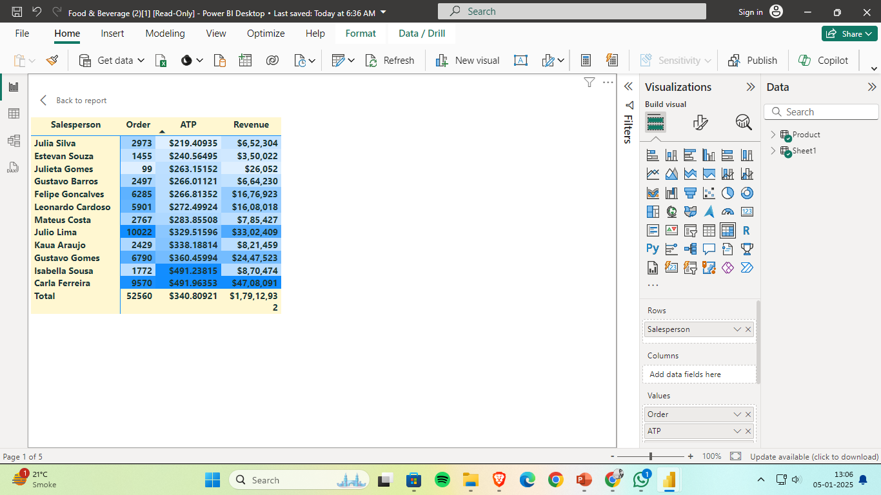
VISUALIZATION
Slicer
Stacked Bar Chart
Matrix
X axis - Revenue
Y axis – Product Group
Which help to known the Revenue by Product Category
Rows : Salesperson
Values: Orders, Revenue, ATP
Its help to show the Order, Revenue & ATP by Salesperson

Slide 10
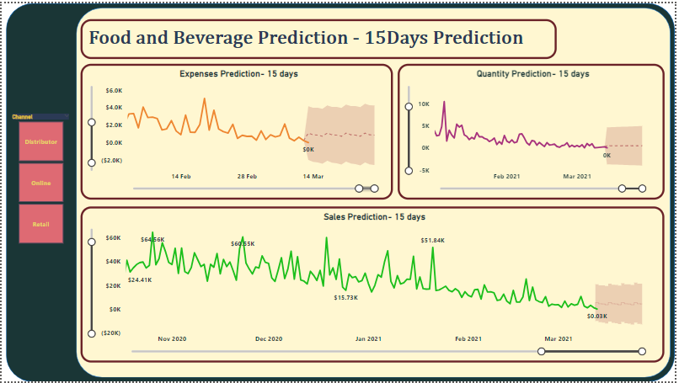
FORECASTING
15 Days Sale Forecast
15 Days Expense Forecast
15 Quantity Forecast
These the data will help to take decision regarding
Inventory management
Cost Management
Production

Slide 11

VISUALIZATION
Slicer
1. Product Category
2. Channel
3. Year
Field : Product Category
Field : Channel
Field: Year

Slide 12
Question & Answer
Which is the Month for were the Highest Sell Reported ?
Who is the SALE PERSON under that highest Sale Reported ?
Top 5 Product Category where the most of the revenue come from ?

Slide 13
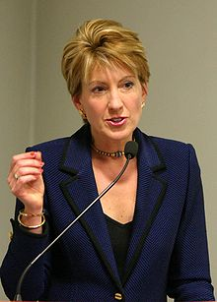
"The goal is to turn data into information, and information into insight." – Carly Fiorina
THANK YOU

